Slide 1
Hyperthyroidism
Dr Swaapnika

Slide 2
Hyperthyroidism- is the result of excessive thyroid function.
Thyrotoxicosis is defined as the state of thyroid hormone excess.
The major etiologies of thyrotoxicosis are hyperthyroidism caused by Graves’ disease, toxic MNG, and toxic adenomas.

Slide 3
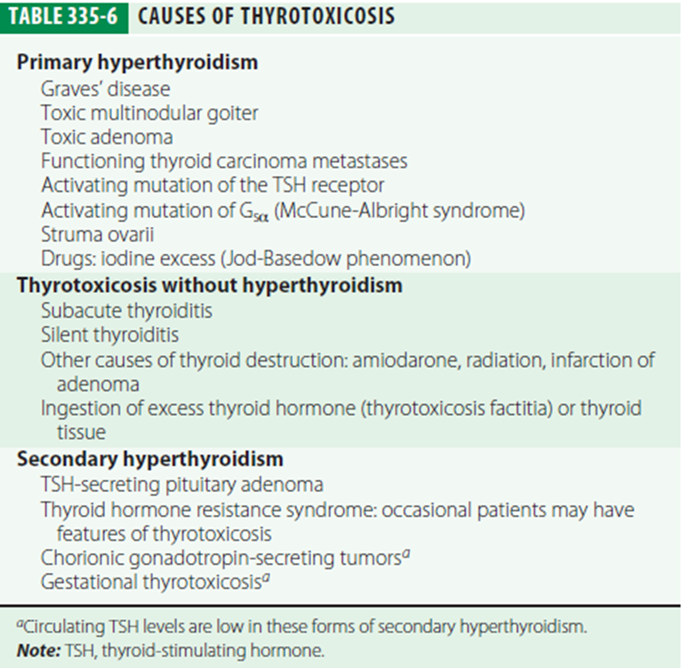

Slide 4
GRAVES’ DISEASE
Graves’ disease accounts for 60–80% of thyrotoxicosis.
As in autoimmune hypothyroidism, a combination of environmental and genetic factors, including polymorphisms in HLADR, CTLA-4, and PTPN22 (a T cell regulatory gene), contribute to Graves’ disease susceptibility.
Smoking is a minor risk factor for Graves’ disease and a major risk factor for the development of ophthalmopathy.
The hyperthyroidism of Graves’ disease is caused by TSI (thyroid stimulating immunoglobulin) that are synthesized in the thyroid gland as well as in bone marrow and lymph nodes.

Slide 5
Graves’ patients in whom high levels of TSI can cross the placenta and cause neonatal thyrotoxicosis.
Cytokines appear to play a major role in thyroid-associated ophthalmopathy. There is infiltration of the extraocular muscles by activated T cells; the release of cytokines such as IFN-gamma, TNF, and IL-1 results in fibroblast activation and increased synthesis of glycosaminoglycans that trap water, thereby leading to characteristic muscle swelling.

Slide 6
Increased fat is an additional cause of retrobulbar tissue expansion. The increase in intraorbital pressure can lead to proptosis, diplopia, and optic neuropathy.
Late in the disease, there is irreversible fibrosis of the muscles.

Slide 7
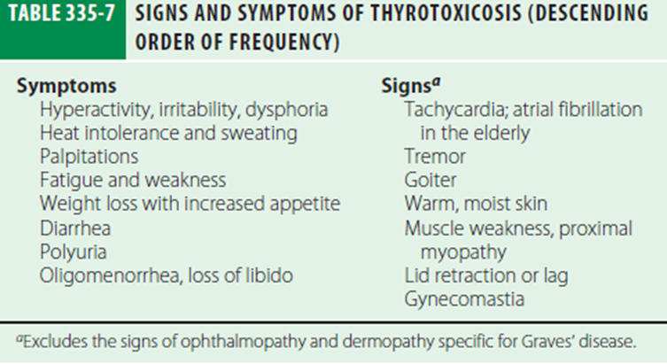
Clinical manifestations

Slide 8
In the elderly, features of thyrotoxicosis may be subtle or masked, and patients may present mainly with fatigue and weight loss, a condition known as apathetic thyrotoxicosis.
Thyrotoxicosis may cause unexplained weight loss, despite an enhanced appetite, due to the increased metabolic rate.

Slide 9
Fine tremor is a frequent finding, best elicited by having patients stretch out their fingers while feeling the fingertips with the palm.
Thyrotoxicosis is sometimes associated with a form of hypokalemic periodic paralysis.
Common neurologic manifestations include hyperreflexia, muscle wasting, and proximal myopathy without fasciculation.

Slide 10
The direct effect of thyroid hormones on bone resorption leads to osteopenia in longstanding thyrotoxicosis; mild hypercalcemia occurs in up to 20% of patients, but hypercalciuria is more common.
In Graves’ disease the thyroid is usually diffusely enlarged to two–three times its normal size.
Lid retraction, causing a staring appearance, can occur in any form of thyrotoxicosis and is the result of sympathetic overactivity.

Slide 11
The earliest manifestations of ophthalmopathy are usually a sensation of grittiness, eye discomfort, and excess tearing.
Scoring system to gauge the extent and activity of the orbital changes in Graves’ disease-The “NO SPECS” scheme

Slide 12
0 = No signs or symptoms
1 = Only signs (lid retraction or lag), no symptoms
2 = Soft tissue involvement (periorbital edema)
3 = Proptosis (>22 mm)
4 = Extraocular muscle involvement (diplopia)
5 = Corneal involvement
6 = Sight loss

Slide 13
Thyroid dermopathy occurs in <5% of patients with Graves’ disease , almost always in the presence of moderate or severe ophthalmopathy.
Thyroid acropachy refers to a form of clubbing found in <1% of patients with Graves’ disease

Slide 14
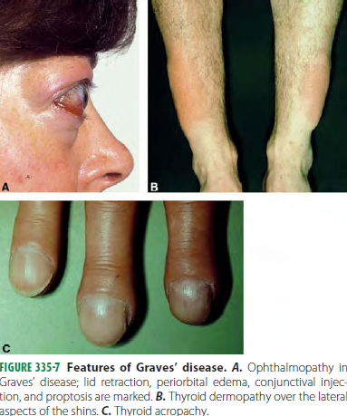

Slide 15
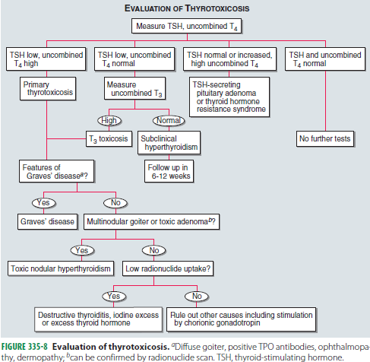

Slide 16
TSH level is suppressed and total and unbound thyroid hormone levels are increased in Graves disease.
Measurement of TBII(TSH binding inhibitor immunoglobulin) or TSI will confirm the diagnosis but is not needed routinely.
Elevation of bilirubin, liver enzymes, and ferritin.
Microcytic anemia and thrombocytopenia may occur.

Slide 17
Clinical features of thyrotoxicosis can mimic certain aspects of other disorders, including panic attacks, mania, pheochromocytoma, and weight loss associated with malignancy.
The diagnosis of thyrotoxicosis can be easily excluded if the TSH and unbound T3 levels are normal.

Slide 18
There may be fluctuation between hypo and hyperthyroidism due to changes in the functional activity of TSH-R antibodies.
Ophthalmopathy typically worsens over the initial 3–6 months, followed by a plateau phase over the next 12–18 months, with spontaneous improvement, particularly in the soft tissue changes.

Slide 19
Diplopia may appear late in the disease due to fibrosis of the extraocular muscles.
Thyroid dermopathy, when it occurs, usually appears 1–2 years after the development of Graves’ hyperthyroidism; it may improve spontaneously.

Slide 20
Treatment
The hyperthyroidism of Graves’ disease is treated by reducing thyroid hormone synthesis, using antithyroid drugs, or reducing the amount of thyroid tissue with radioiodine (131I) treatment or by thyroidectomy.
The main antithyroid drugs are the thionamides, such as propylthiouracil, carbimazole, and the active metabolite of the latter, methimazole. All inhibit the function of TPO, reducing oxidation and organification of iodide.
Propylthiouracil inhibits deiodination of T4 to T3.

Slide 21
There are many variations of antithyroid drug regimens. The initial dose of carbimazole or methimazole is usually 10–20 mg every 8 or 12 h.
Propylthiouracil is given at a dose of 100–200 mg every 6–8 h, and divided doses are usually given throughout the course.
High doses may be given combined with levothyroxine supplementation (block-replace regimen) to avoid drug-induced hypothyroidism.

Slide 22
Thyroid function tests and clinical manifestations are reviewed 3–4 weeks after starting treatment, and the dose is titrated based on unbound T4 levels.
It takes 6 – 8 weeks to achieve euthyroidism after the initiation of the treatment.
The usual daily maintenance doses of antithyroid drugs in the titration regimen are 2.5–10 mg of carbimazole or methimazole and 50–100 mg of propylthiouracil.

Slide 23
The common side effects of antithyroid drugs are rash, urticaria, fever, and arthralgia (1–5% of patients).
Need to watch for symptoms of possible agranulocytosis (e.g., sore throat, fever, mouth ulcers)

Slide 24
Propranolol (20–40 mg every 6 h) or longer-acting beta blockers such as atenolol, may be helpful to control adrenergic symptoms, especially in the early stages before antithyroid drugs take effect.
The need for anticoagulation with coumadin should be considered in all patients with atrial fibrillation.

Slide 25
Radioiodine causes progressive destruction of thyroid cells and can be used as initial treatment or for relapses after a trial of antithyroid drugs.
Propylthiouracil has a prolonged radioprotective effect and should be stopped several weeks before radioiodine is given.

Slide 26
131I dosage generally ranges between 185 MBq (5 mCi) to 555 MBq (15 mCi).
Hyperthyroidism can persist for 2–3 months before radioiodine takes full effect. For this reason, beta-adrenergic blockers or antithyroid drugs can be used to control symptoms during this interval.

Slide 27
Persistent hyperthyroidism can be treated with a second dose of radioiodine, usually 6 months after the first dose.
Pregnancy and breast feeding are absolute contraindications to radioiodine treatment, but patients can conceive safely 6 months after treatment.

Slide 28
Subtotal or near-total thyroidectomy is an option for patients who relapse after antithyroid drugs and prefer this treatment to radioiodine.
Careful control of thyrotoxicosis with antithyroid drugs, followed by potassium iodide (3 drops orally tid), is needed prior to surgery to avoid thyrotoxic crisis and to reduce the vascularity of the gland.

Slide 29
Propylthiouracil is usually used because of relatively low transplacental transfer and its ability to block T4 to T3 conversion.

Slide 30
Thyrotoxic crisis, or thyroid storm, is rare and presents as a life-threatening exacerbation of hyperthyroidism, accompanied by fever, delirium, seizures, coma, vomiting, diarrhea, and jaundice.
Large doses of propylthiouracil (600 mg loading dose and 200–300 mg every 6 h) should be given orally or by nasogastric tube or per rectum; the drug’s inhibitory action on T4 to T3 conversion makes it the antithyroid drug of choice.

Slide 31
One hour after the first dose of propylthiouracil, stable iodide is given to block thyroid hormone synthesis via the Wolff-Chaikoff effect (the delay allows the antithyroid drug to prevent the excess iodine from being incorporated into new hormone).
Ophthalmopathy requires no active treatment when it is mild or moderate, as there is usually spontaneous improvement.

Slide 32
THYROIDITIS
A clinically useful classification of thyroiditis is based on the onset and duration of disease.
The patient presents with thyroid pain, often referred to the throat or ears, and a small, tender goiter that may be asymmetric.
The erythrocyte sedimentation rate (ESR) and white cell count are usually increased, but thyroid function is normal. FNA biopsy shows infiltration by polymorphonuclear leukocytes; culture of the sample can identify the organism

Slide 33
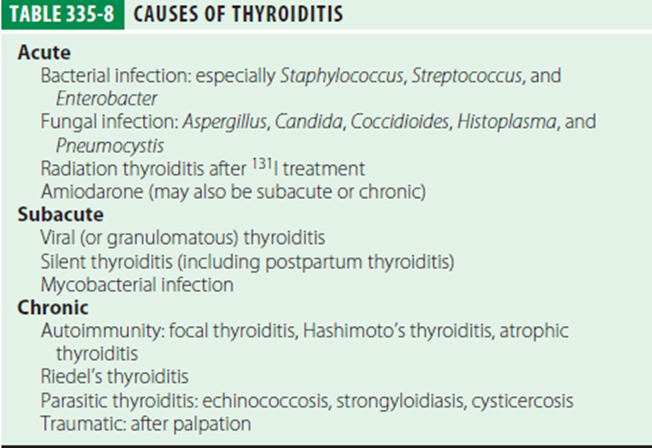

Slide 34
The differential diagnosis of thyroid pain includes
Subacute thyroiditis
Chronic thyroiditis
Hemorrhage into a cyst
Malignancy including lymphoma
Amiodarone-induced thyroiditis or
Amyloidosis.

Slide 35
Antibiotic treatment is guided initially by Gram stain and subsequently by cultures of the FNA biopsy.
Surgery to drain the abscess.

Slide 36
SUBACUTE THYROIDITIS
This is also termed de Quervain’s thyroiditis, granulomatous thyroiditis, or viral thyroiditis.
Viral etiology-mumps, coxsackie, influenza.
Symptoms can mimic pharyngitis.
During the initial phase of follicular destruction, there is release of Tg and thyroid hormones, leading to increased circulating T4 and T3 and suppression of TSH.
Later stages shows increase in TSH and increased radio iodine uptake.

Slide 37
Clinical Manifestations
Painful and enlarged thyroid, sometimes accompanied by fever.
Malaise and symptoms of an upper respiratory tract infection may precede the thyroid-related features by several weeks.
The patient typically complains of a sore throat, and examination reveals a small goiter that is exquisitely tender.

Slide 38
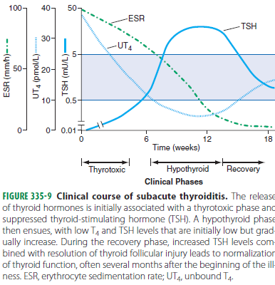

Slide 39
The diagnosis is confirmed by a high ESR and low radioiodine uptake.
Relatively large doses of aspirin (e.g., 600 mg every 4–6 h) or NSAIDs are sufficient to control symptoms in many cases.
Glucocorticoids -The usual starting dose is 40–60 mg prednisone, depending on severity.

Slide 40
SILENT THYROIDITIS
Painless thyroiditis, or “silent” thyroiditis, occurs in patients with underlying autoimmune thyroid disease.
Typically, patients have a brief phase of thyrotoxicosis lasting 2–4 weeks, followed by hypothyroidism for 4–12 weeks, and then resolution.

Slide 41
In addition to the painless goiter, silent thyroiditis can be distinguished from subacute thyroiditis by a normal ESR and the presence of TPO antibodies.
Glucocorticoids are not indicated for silent thyroiditis.
Severe thyrotoxic symptoms can be managed with a brief course of propranolol, 20–40 mg three or four times daily.

Slide 42
SICK EUTHYROID SYNDROME
Any acute, severe illness can cause abnormalities of circulating TSH or thyroid hormone levels in the absence of underlying thyroid disease.
Cause is the release of cytokines such as IL-6.

Slide 43
The most common hormone pattern in sick euthyroid syndrome (SES) is a decrease in total and unbound T3 levels (low T3 syndrome) with normal levels of T4 and TSH.
Very sick patients may exhibit a dramatic fall in total T4 and T3 levels (low T4 syndrome). This state has a poor prognosis

Slide 44
History is vital
No laboratory investigations needed.
Treatment is usually not required and subsequent thyroid functions need to be moitored.

Slide 45
THYROID FUNCTION IN PREGNANCY
Five factors alter thyroid function in pregnancy
(1) the transient increase in hCG during the first trimester, which stimulates the TSH-R.
(2) the estrogen-induced rise in TBG during the first trimester, which is sustained during pregnancy.
(3) alterations in the immune system, leading to the onset, exacerbation, or amelioration of an underlying autoimmune thyroid disease.
(4) increased thyroid hormone metabolism by the placenta.
(5) increased urinary iodide excretion, which can cause impaired thyroid hormone production in areas of marginal iodine sufficiency.

Slide 46
hCG-induced changes in thyroid function can result in transient gestational hyperthyroidism and/or hyperemesis gravidarum, a condition characterized by severe nausea and vomiting and risk of volume depletion.
Thyroid hormone requirements are increased by 25–50 mic g/d during pregnancy.

Slide 47
GOITER AND NODULAR THYROID DISEASE
Goiter refers to an enlarged thyroid gland. Biosynthetic defects, iodine deficiency, autoimmune disease, and nodular diseases can each lead to goiter, though by different mechanisms.
In Graves’ disease, the goiter results mainly from the TSH-R–mediated effects of TSI.
The goitrous form of Hashimoto’s thyroiditis occurs because of acquired defects in hormone synthesis, leading to elevated levels of TSH and its consequent growth effects.

Slide 48
Nodular disease is characterized by the disordered growth of thyroid cells, often combined with the gradual development of fibrosis.
When diffuse enlargement of the thyroid occurs in the absence of nodules and hyperthyroidism, it is referred to as a diffuse nontoxic goiter. This is sometimes called simple goiter, because of the absence of nodules, or colloid goiter.

Slide 49
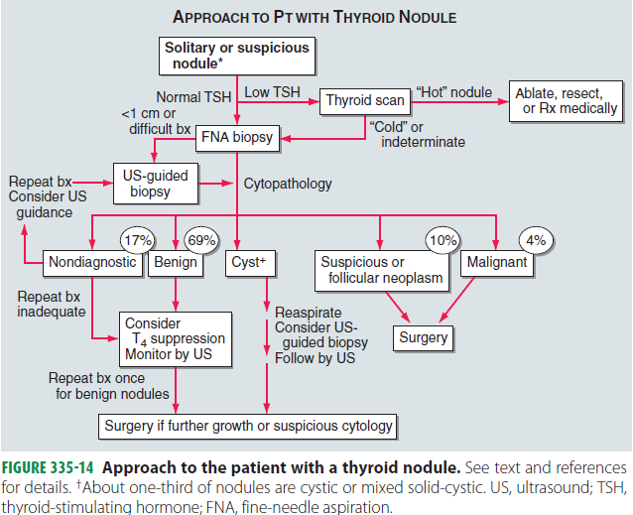

Slide 50
Most patients with thyroid nodules have normal thyroid function tests.
TSH is suppressed, a radionuclide scan is indicated to determine if the identified nodule is “hot,” as lesions with increased uptake are almost never malignant and FNA is unnecessary.

Slide 51
Thank you

